Slide 1
INFO 341 Data Traveling Through the Network
By
Bob Larson

Slide 2
Topics
Data Passing Through Switch or Router
All the Headers, Data, and the Trailer
Changes in Headers

Slide 3

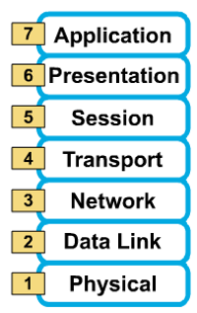
Data Passing Through Switch or Router
A
B
Data
Data
Data
Segment
Packet
Frame
Bits
Switch
Router

Slide 4
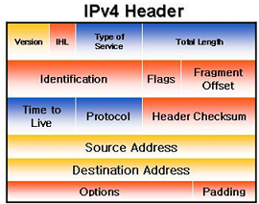
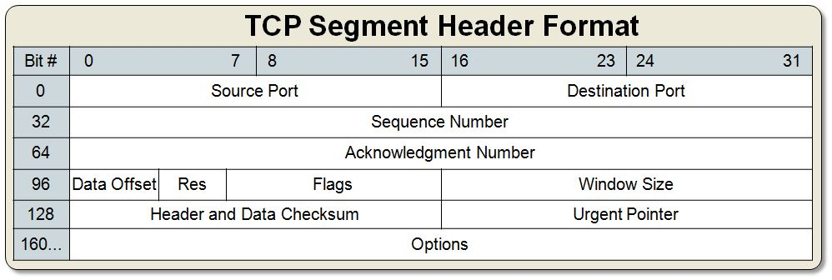

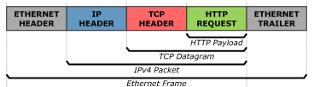
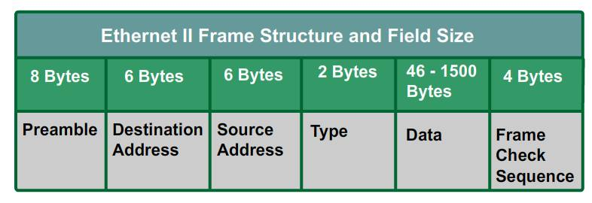
All the Headers, Data, and the Trailer
Never Forget it is just:

Slide 5
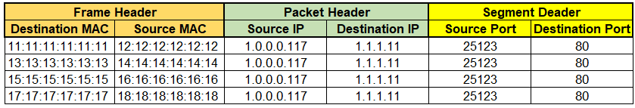



Changes in Headers
Web Server 1
1.1.1.10 /24
15:15:15:15:15:15
1.1.1.1 /24
17:17:17:17:17:17
Internet
14:14:14:14:14:14
Web Server 2
1.1.1.11 /24
1.2.2.1 /30
16:16:16:16:16:16
18:18:18:18:18:18
1.2.2.2 /30
13:13:13:13:13:13
Router or Firewall
1.0.0.1/24
.180
12:12:12:12:12:12
.111
.5
File Server
Switch
.159
.6
Web Server
WiFi Access Point
11:11:11:11:11:11
.100
.121
.113
.170

Slide 6
Fin…

